Slide 1
BENEVOLENT MUDZINGANYAMA B1851682 PEER TO PEER DELIVERY WITH BLOCKCHAIN SUPERVISOR: MR CHAKA

Slide 2
INTRODUCTION
Delivery is the backbone of online shopping. Therefore it is an important aspect that one must get right when running an online business.
The needs of customers have significantly changed, and the majority now demand a quick, dependable delivery service. Goods used to be delivered in 7-10 working days, with very few options available to customers. However, as technology has advanced, so has the number of available delivery methods and options.
Delivery is also the customer's last impression of your company. So, if they have a problem, it will give them an unfavourable impression of your brand, and they will be hesitant to buy from you again.

Slide 3
BACKGROUND OF PROBLEM
With the rise of online commerce during the pandemic and past it, customers can just fire up their devices, get to the seller’s website, add a couple items to the cart, go to checkout, and that’s it, a purchase is made
It is however, after a purchase of a product is completed that a new problem would emerge, that is the painstaking delivery process.
Most deliveries are associated with the following:
Long and complex logistics chains involving multiple organisations
Lack of trust and limited collaboration
Lack of end-to-end transparency caused by a restricted flow of information, challenges related to tracing and tracking, as well as underutilisation of assets

Slide 4
RESEARCH OBJECTIVES
To design and develop a blockchain system which allow peer to peer deliveries.
To implement blockchain technology through use of smartcontracts and consensus algorithms for peer to peer delivery transaction validation, trustworthy and verification.
To evaluate delivery transaction traceability and transparency

Slide 5
RESEARCH QUESTIONS
How does the system allows peer to peer deliveries?
To what extent do blockchain algorithms archive delivery transaction validation, trustworthy and verification.
How does the system evaluate delivery transaction traceability and transparency?

Slide 6
HYPOTHESIS
Null Hypothesis (H0): The use of a blockchain aided peer to peer delivery system reduces complexity, improve transparency and boost trust in the delivery process
Alternative Hypothesis (H1): The use of a blockchain aided peer to peer delivery system does not reduces complexity, improve transparency and boost trust in the delivery process.

Slide 7
METHODOLOGY
Agile method: agile development model creates room for the model to be tested whilst still under development .Also this allows the researcher to test the model whilst it has a set of limited functions due to the use of prototyping.
Agile method allows faster development of the model hence it can be delivered earlier .Waterfall model is needed when developing large models, also waterfall models down the design and development of the proposed model with the required time for it to be delivered

Slide 8
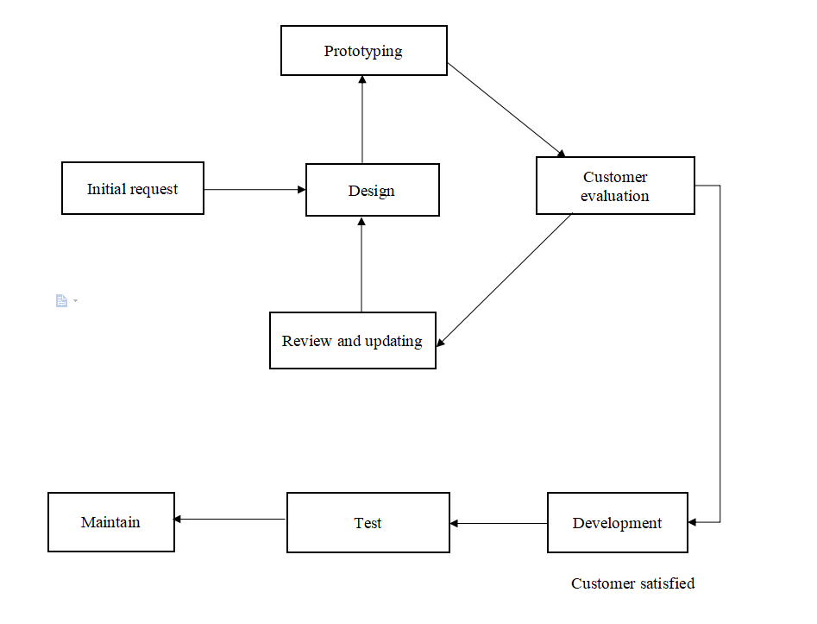
BUILD METHODOLOGY

Slide 9
ADVANTAGES OF AGILE
In Agile methodology the delivery of software is unremitting.
The customers are satisfied because after every Sprint working feature of the software is delivered to them.
Customers can have a look of the working feature which fulfilled their expectations.
If the customers has any feedback or any change in the feature then it can be accommodated in the current release of the product.
In Agile methodology the daily interactions are required between the business people and the developers.
In this methodology attention is paid to the good design of the product.
Changes in the requirements are accepted even in the later stages of the development.

Slide 10
DISADVANTAGES OF AGILE
In Agile methodology the documentation is less.
Sometimes in Agile methodology the requirement is not very clear hence it’s difficult to predict the expected result.
In few of the projects at the starting of the software development life cycle it’s difficult to estimate the actual effort required.
Because of the ever-evolving features, there is always a risk of the ever-lasting project.
For complex projects, the resource requirement and effort are difficult to estimate.

Slide 11
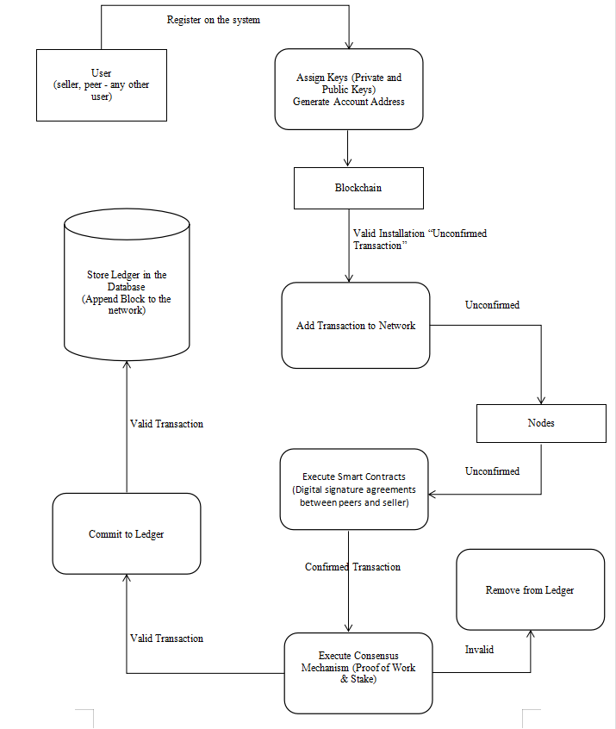
GENERAL OVERVIEW OF THE SYSTEM

Slide 12
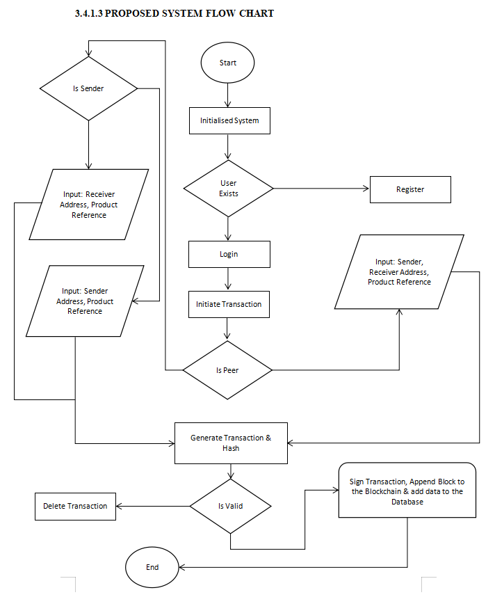
SYSTEM FLOWCHART

Slide 13
RESULTS AND ANALYSIS
WHITE BOX TESTING
White box testing is a procedure of software validation/evaluation through testing the internal components of the system as stated to its prescribed functionality. In white box testing the internal standpoint of the system is used to design the test cases. The author performed this test to check how the system handle certain cases.
BLACK BOX TESTING
Black box testing refers to the evaluations performed that only take into account the system’s behavior externally. Black box testing allows even an individual without the knowledge of the internal components of the system to test it against its functional and non-functional requirements .The individual can only have the knowledge of what the system must do, how to navigate around the system and operate it.

Slide 14
EVALUATION OF RESULTS
System evaluation includes measuring the final system against its initial performance goals as well as performing ongoing testing to see that the system continues to meet those goals.
Blockchain networks rely on consensus algorithms and smart contracts to reach agreement among various distributed nodes.
A consensus mechanism such as proof of work (PoW) secures the network and prevents unauthorized users from validating bad transactions.
Smart contracts are self-executing contracts in which the contents of the buyer-seller agreement are inscribed directly into lines of code. The author will use these mechanisms to evaluate the system.

Slide 15
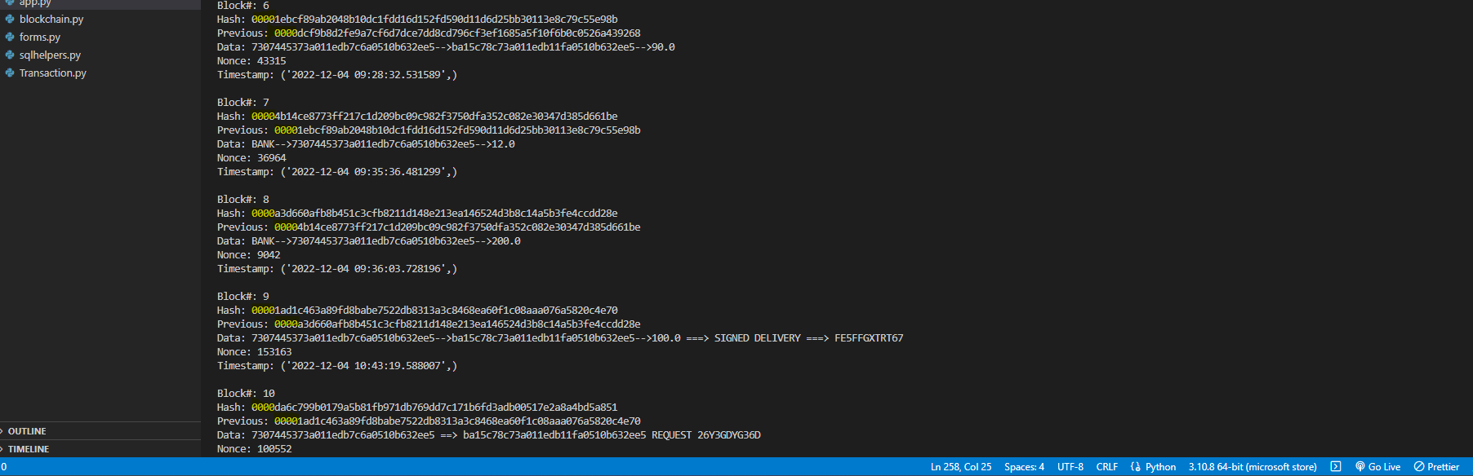
PROOF OF WORK CONSENSUS ALGORITHM

Slide 16
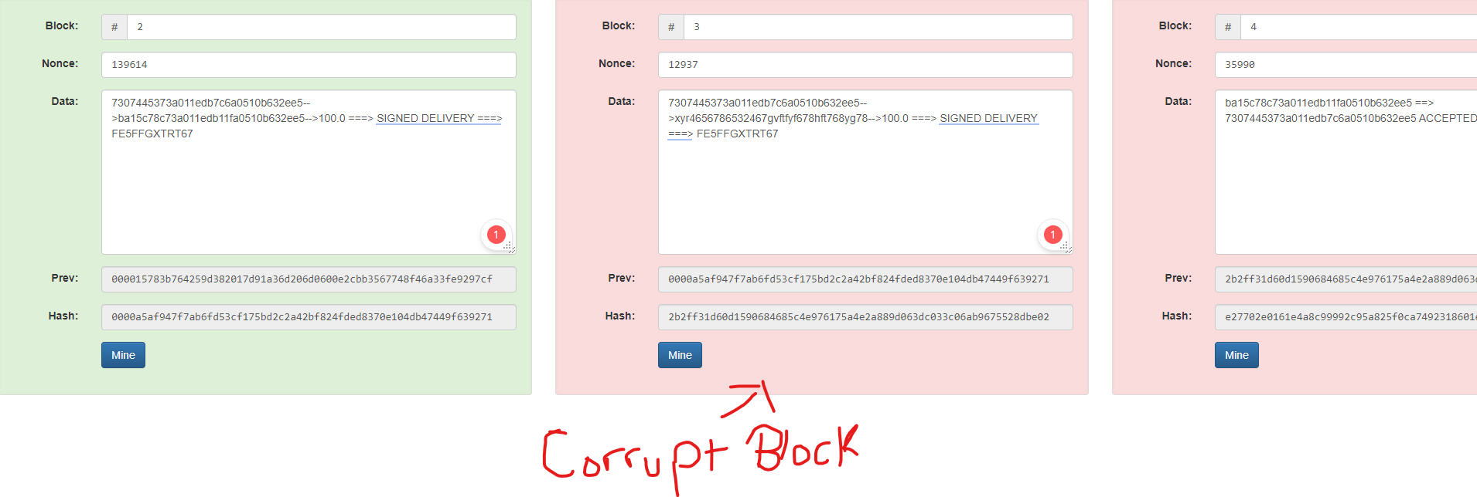
PROOF OF WORK CONT..

Slide 17
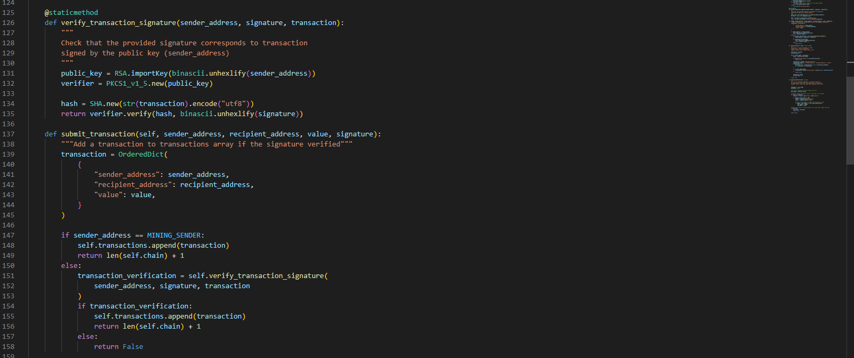
SMART CONTRACTS

Slide 18
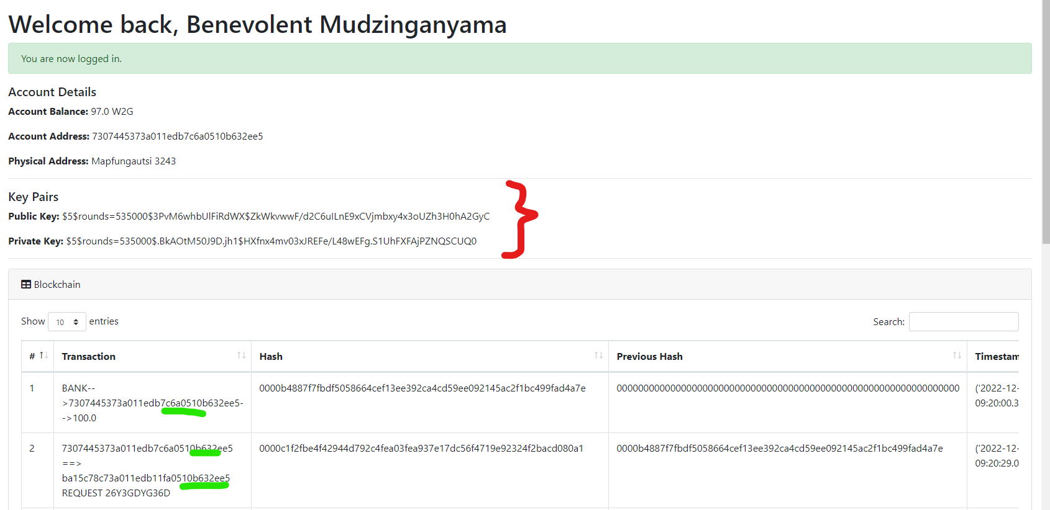
SMART CONTRACTS CONT...

